Slide 1

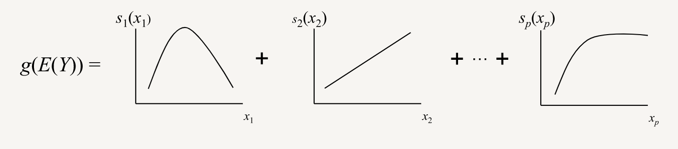
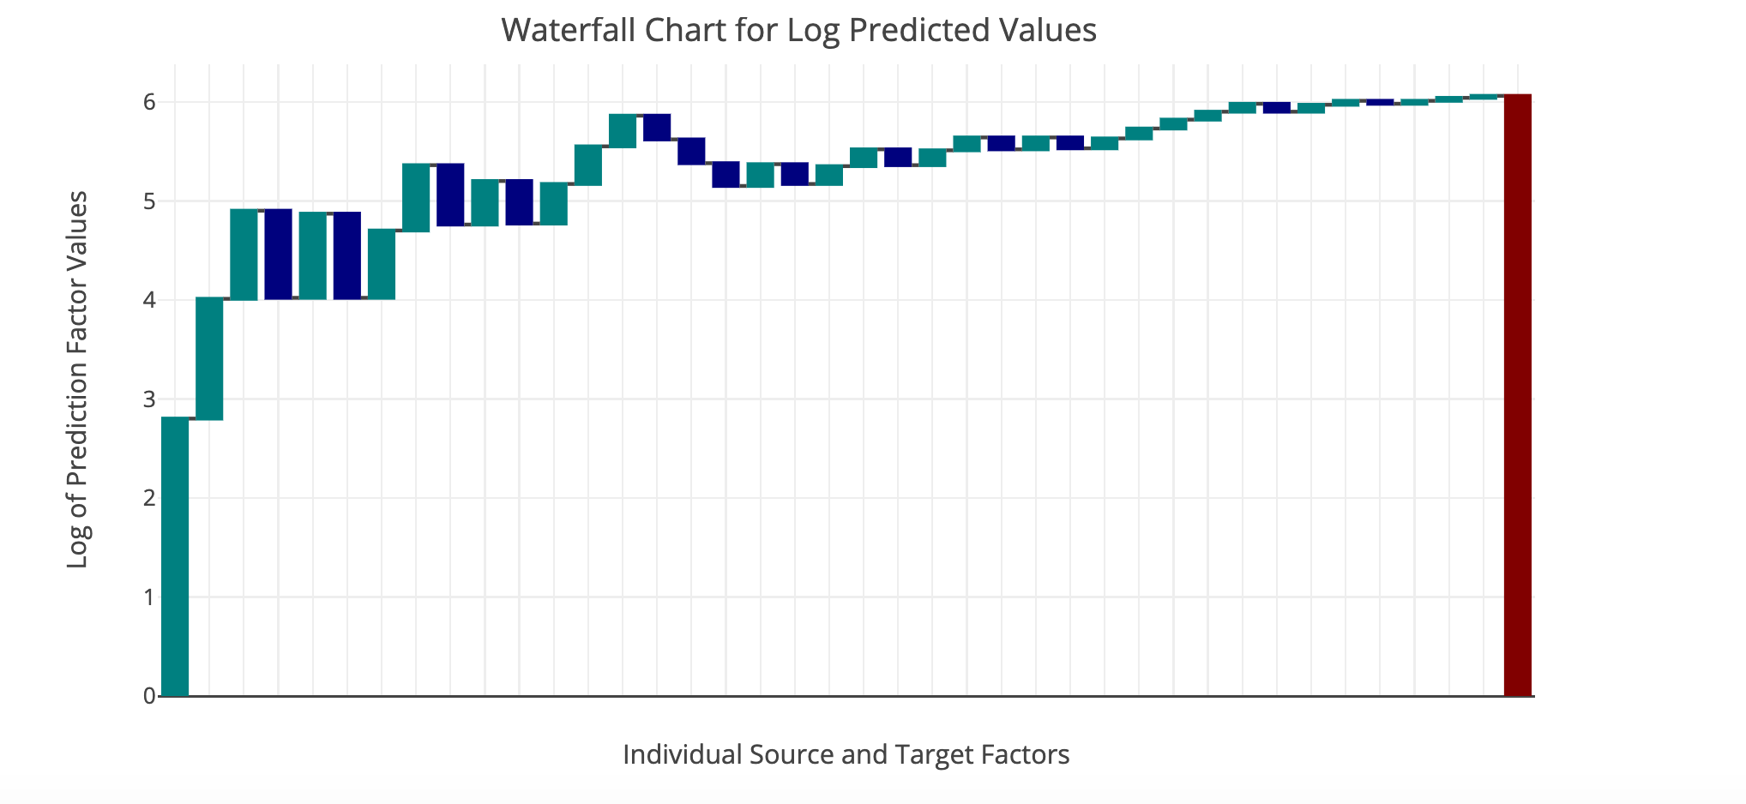
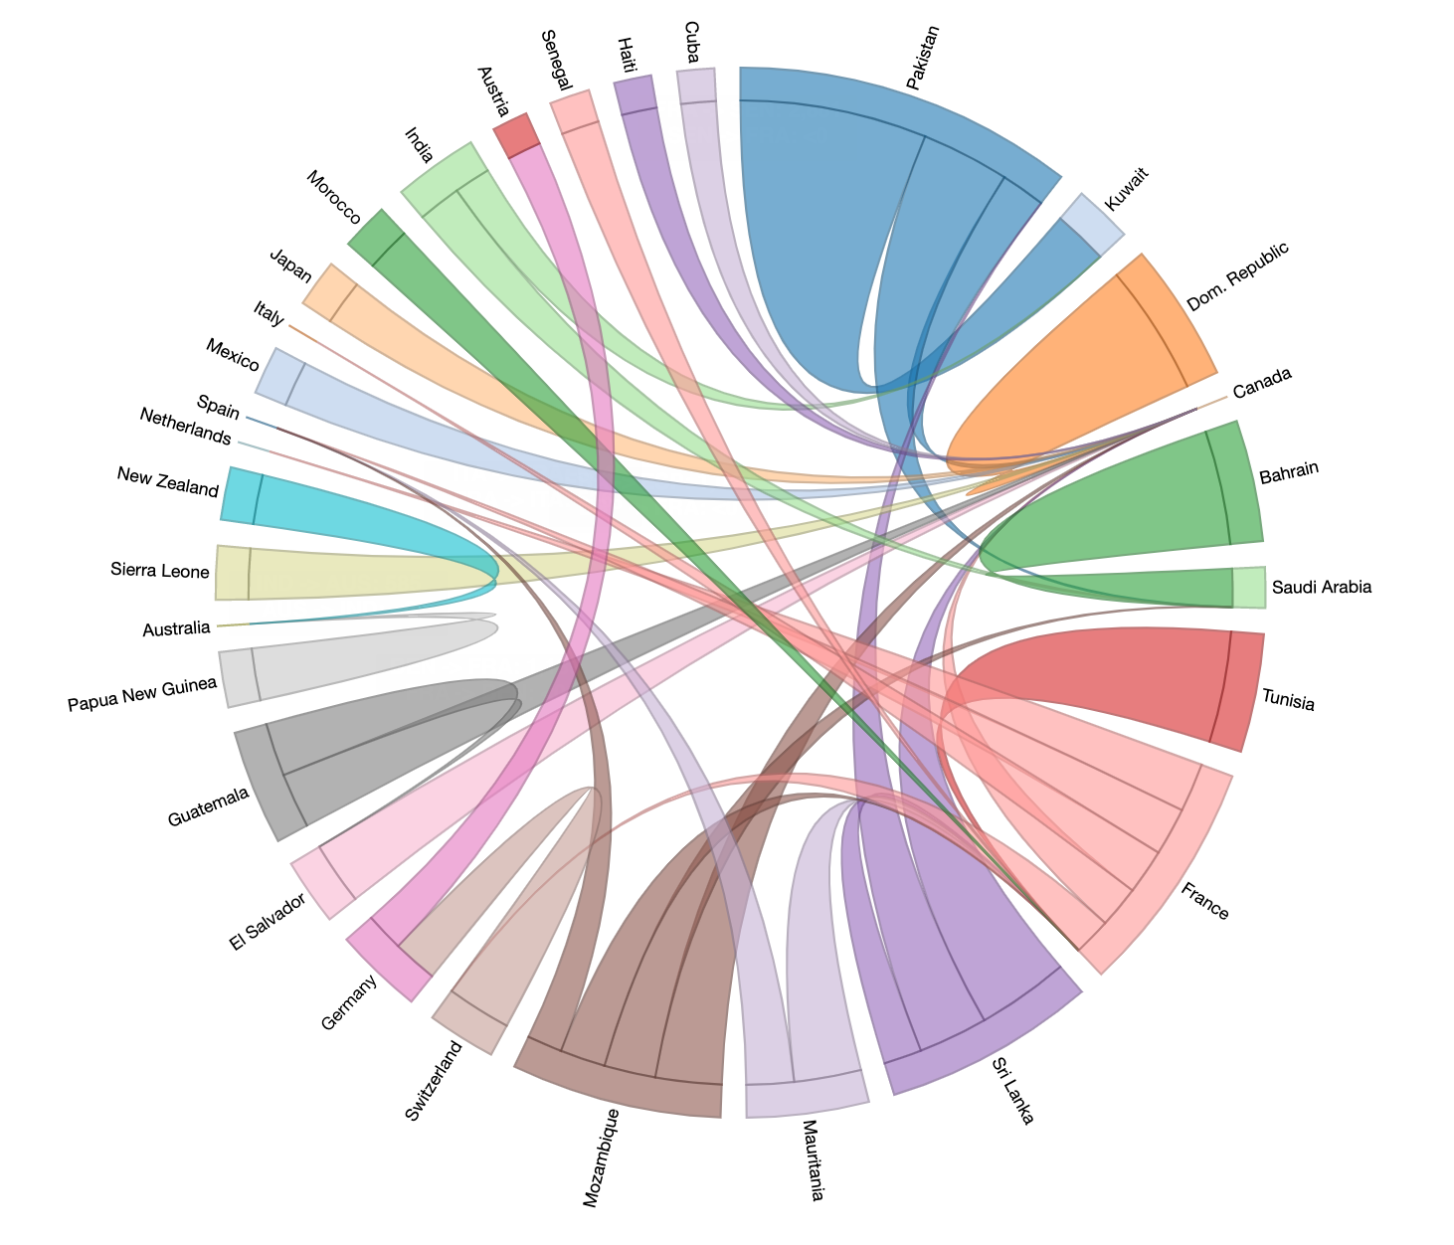
Estimating Impact of Climate
Change on Human Migration
Austin Himschoot, Austin Wright, Chitwan Kaudan, Frank Whitesell, Lipi Shah
MOTIVATION
OUR APPROACH
Problem:
Along with migration, there is a flow of manpower, skills and intellectual resources. Improper documentation or visualization of migration could lead to major issues in employment, economic growth, uneven distribution of resources, exploitation and man and materials and could also heavily imbalance policy decisions and legal regulations.
Importance:
Migration is a transfer of resources, skills and manpower. If properly documented and visualized, it could benefit two countries in better policy making, curtailing on-going economic issues, enhancing globalization and foreign exchange with other nations.
Knowing present scenario of migration to and from one’s country helps acknowledge the cultural diversity and social integration.
It is also aids a proper and even distribution of a nation’s wealth and resources.
What is a GAM? : General Additive Models (GAM) are a technique where “the impact of the predictive variables is captured through smooth functions which—depending on the underlying patterns in the data—can be nonlinear.” Each relationship between a predictor variable and the response are modeled by a non-parametric function simultaneously during model estimation, and the link function of the expected value of the response is equal to a linear combination of each of these non-parametric functions.
Why GAMs? : We are analyzing a complex set of the determinants of migration. GAMs help reduce the noise of the predictor variables and help capture the diversity of relationships between the predictors and the response. Because we are interested in each explanatory variable’s contribution to the predicted migration flow between two countries, a GAM enables a clear visual interpretation of the results.
What’s New: Building a comprehensive model incorporating different causes of migration (economic, demographic, environmental).
Visualization: The visualization combines D3 and R Shiny to create an interactive chord diagram that generates a waterfall chart for individual chords. Shiny allows the visualization to be hosted locally and without Internet access. The chord diagram helps the user visualize the top 50 migration flows in and out of select countries for a given year; it provides an intuitive interpretation of flow sizes. The waterfall chart illustrates the contribution of each factor to the overall migration flow prediction in order of magnitude. Together they can identify strong migration flows and the factors that caused them.
DATA
EXPERIMENTS AND RESULTS
Text and big picture of viz here

